Slide 1
Travel planner agent
IBM HACKATHON PROJECT
Presented By:
Student name : Sanjana Bapu Patil
College Name & Department : Shram sadhana Bombay trust college of engineering and Technology , Jalgaon –
Computer Engineering

Slide 2
OUTLINE
Problem Statement
Technology used
Wow factor
End users
Result
Conclusion
Git-hub Link
Future scope
IBM Certifications

Slide 3
Problem Statement
Travel planning is often time-consuming and complex due to the need to research destinations, book accommodations, manage schedules, and stay updated with real-time conditions like weather or transport delays. Many travelers face challenges in personalizing trips according to their preferences, budgets, and constraints. There is a need for a smart system that can automate and simplify the entire planning process while adapting to real-time changes.
Proposed Solution:
Personalized travel planning based on individual preferences.
Integrates real-time data for weather, location, and cost.
Scalable and modular using IBM Cloud and Watsonx.
Natural conversation-like interactions via AI model.

Slide 4
Technology used
IBM cloud lite services
Natural Language Processing (NLP)
Retrieval Augmented Generation (RAG)
IBM Granite model
Machine Learning

Slide 5
IBM cloud services used
IBM Cloud Watsonx AI Studio
IBM Cloud Watsonx AI runtime
IBM Cloud Agent Lab
IBM Granite foundation model

Slide 6
Wow factors
Automatically creates personalized travel plans (locations, activities, hotels) using user preferences. Integrates live weather, hotel availability, and local attractions using APIs .
Unique features:
A smart system that dynamically adjusts travel plans in real-time based on:
Real-time API data
Budget-aware suggestions

Slide 7
End users
Family and Groups
Solo Travellers
Travel Agenies
International Tourists

Slide 8
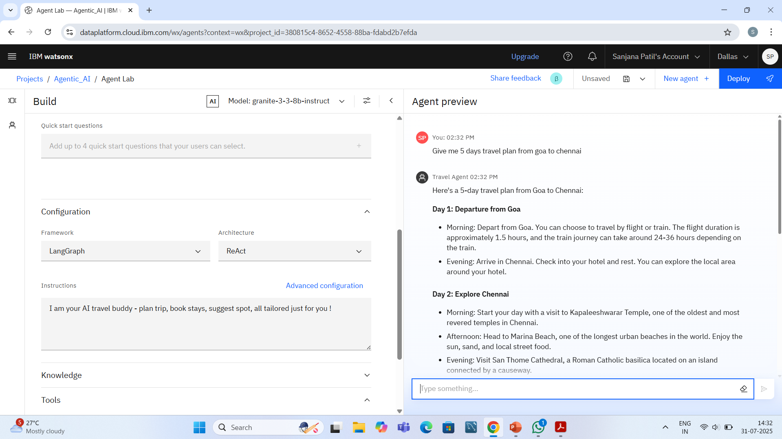
Results

Slide 9
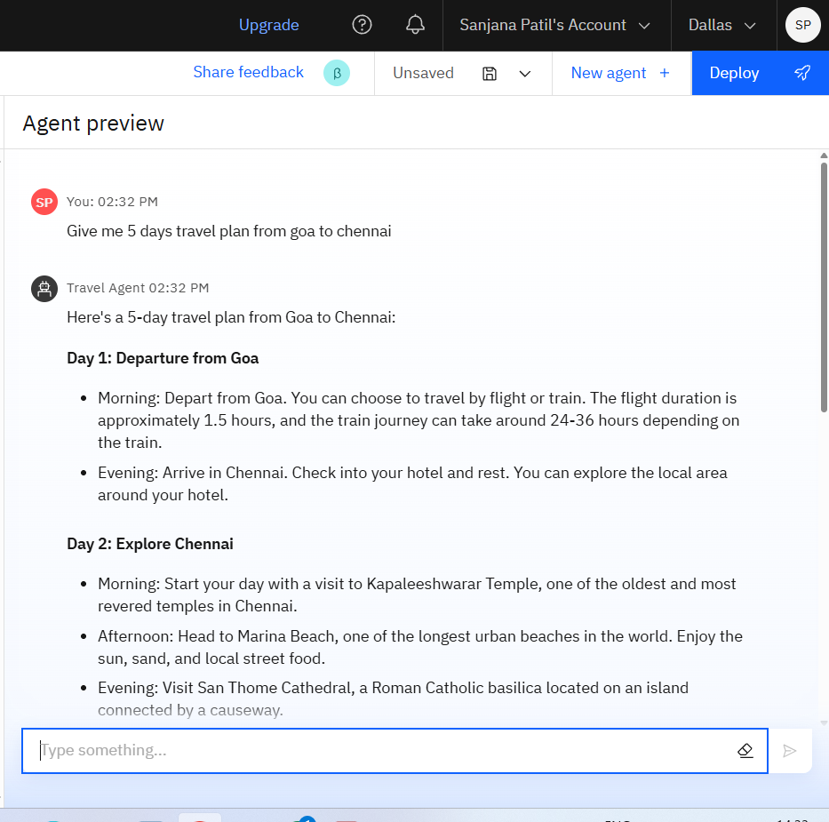
Results

Slide 10
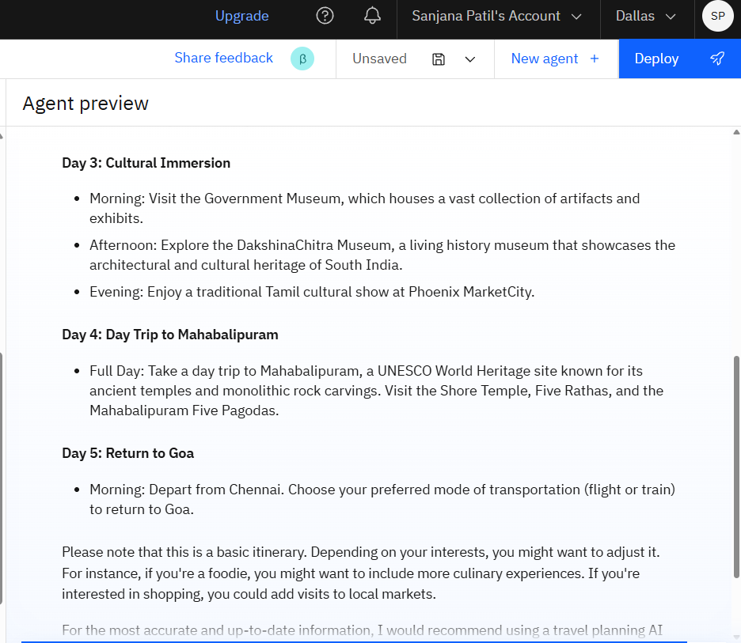
Results

Slide 11
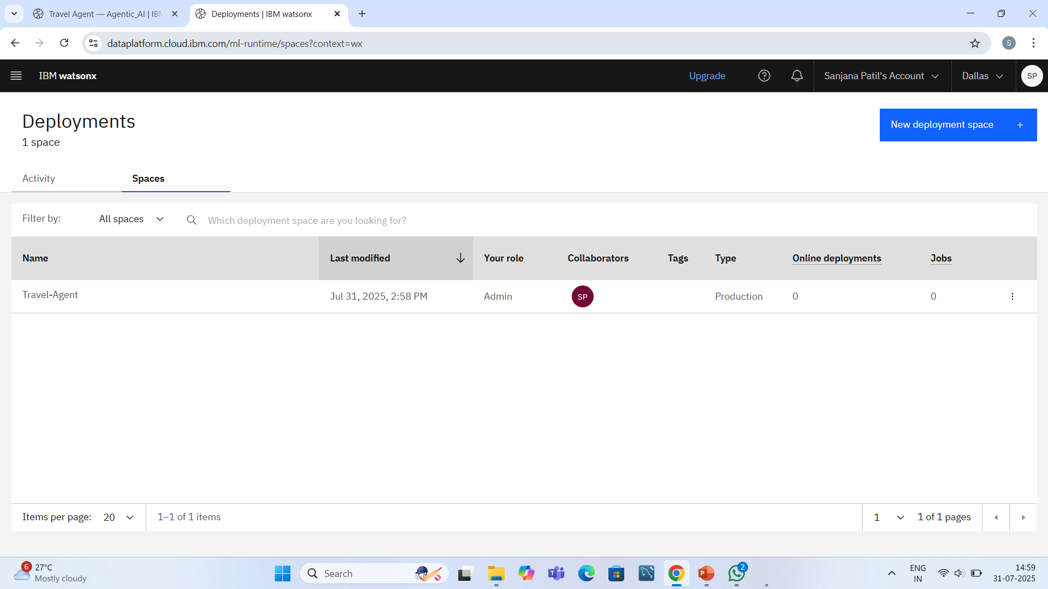
Results
Deployed AI Agent

Slide 12
Conclusion
The Travel Planner Agent simplifies and personalizes the travel experience using real-time intelligence. It reduces manual effort, improves decision-making, and enhances overall satisfaction by dynamically adjusting plans based on live inputs

Slide 13
GitHub Link
https://github.com/Sanjanapatil29

Slide 14
Future scope
Integration with voice assistants (e.g., Siri, Google Assistant)
Offline travel itinerary availability
Multi-user trip coordination (e.g., family/friends planning together)
Support for international languages
More accurate AI predictions using user history and reviews

Slide 15
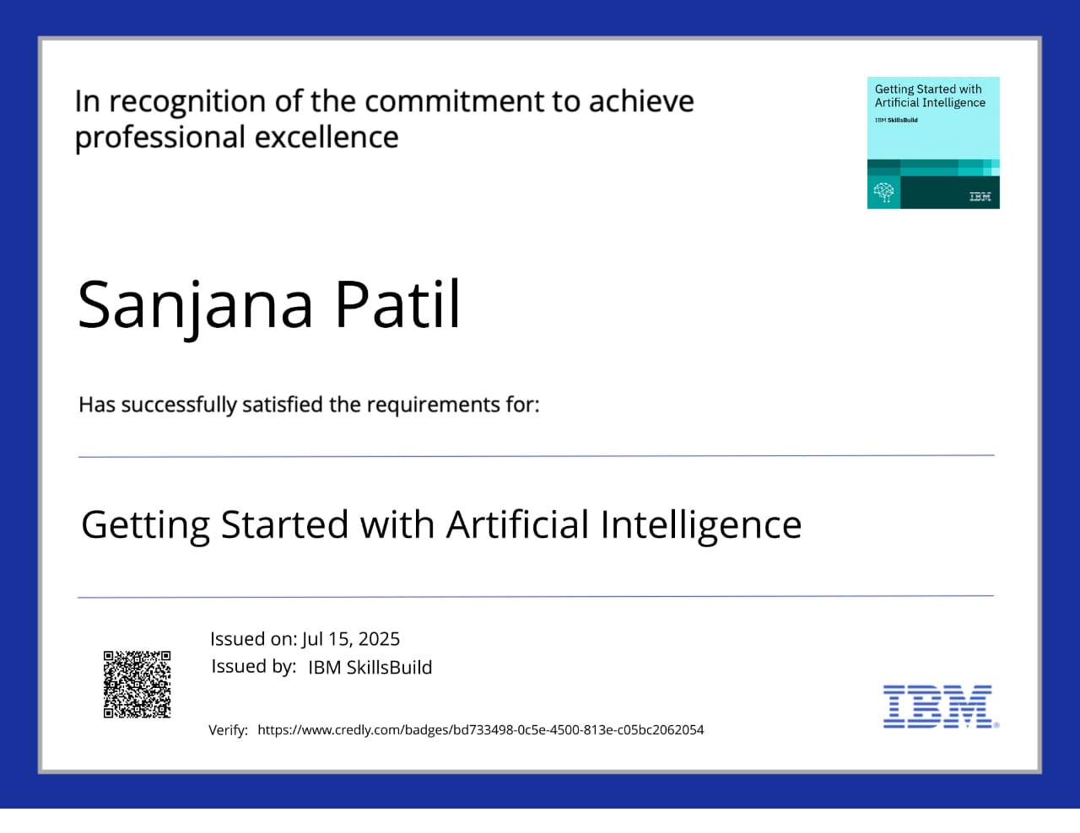
IBM Certifications

Slide 16
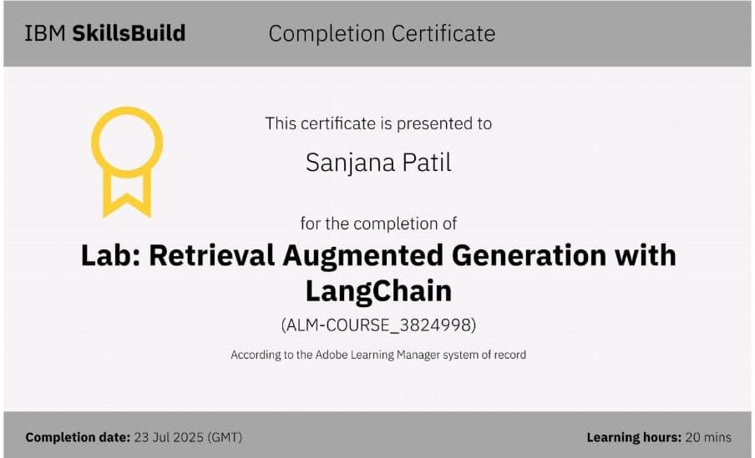

Slide 17
THANK YOU

